Slide 1

Angular js : UI-ROUTER
July 2015
Gauthier Peel

Slide 2
Split an application
Service area
Site = menu + service
Service area = real content
Switch from an activity to another
Use html target to define a state/service
#/todolist/create
Angular-ui-router = librairy managing the routing

Slide 3
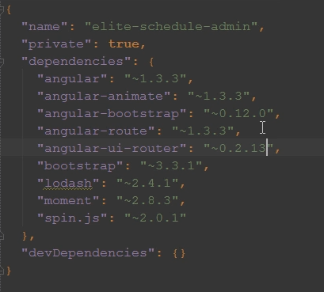
Router
Setup (1/2)
Add a bower dep :
Run >bower install

Slide 4
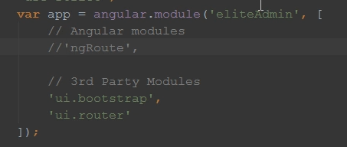
Router
Setup (2/2)
Add the reference to your index.html page
Add it to your angular module deps :

Slide 5
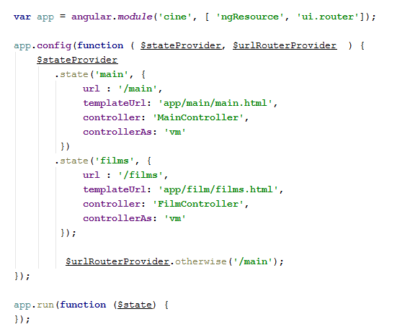
Configuration
Add <div ui-view> in your template file
Define routes
Better : without the '
controller : FilmController

Slide 6
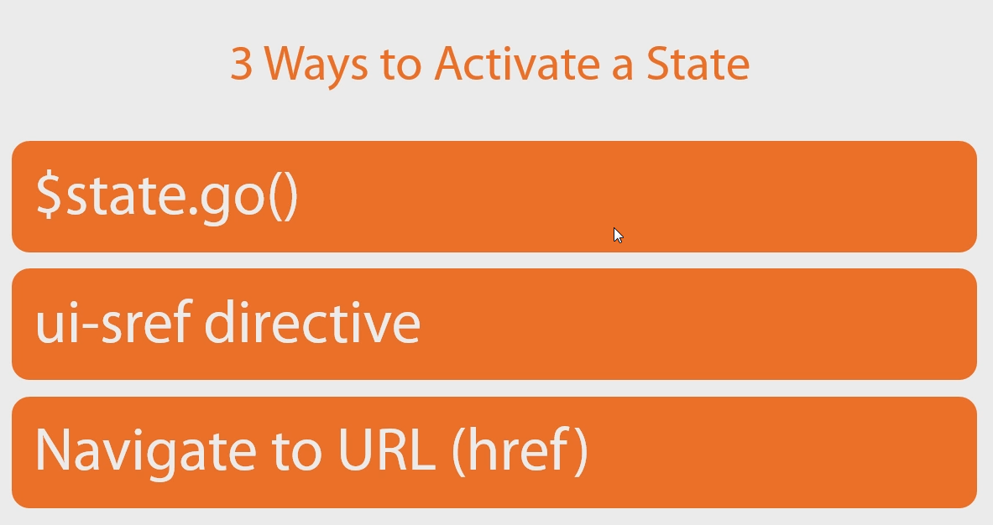
Router
Changing route

Slide 7



Router
Changing Routes
ui-sref could be used on <a>, <button> , on ANYthing !
$state.go
If you want to refresh data, use the reload param as :

Slide 8
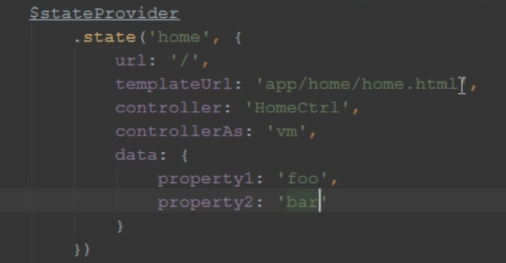
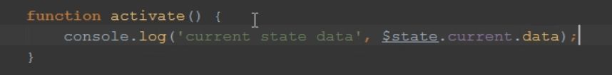

Router
Passing Data
the property name 'data' is required to define some param in the state

Slide 9
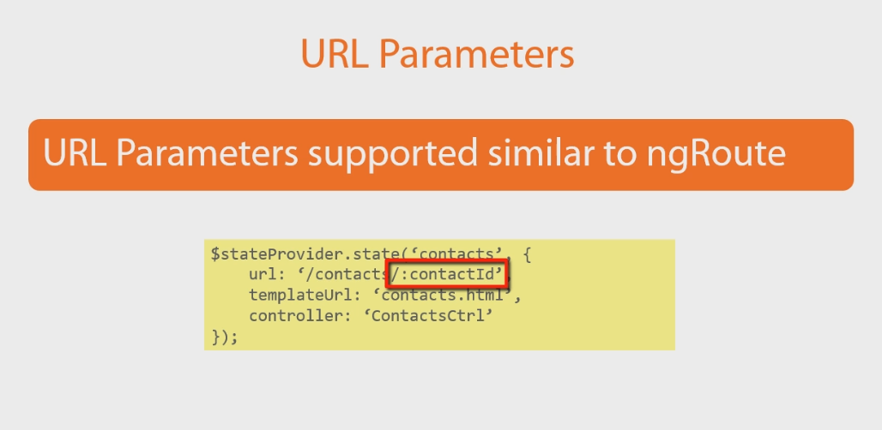
Router
Passing parameters

Slide 10
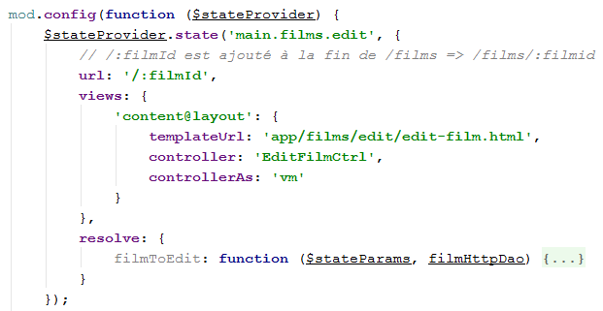

AngularJS

Slide 11
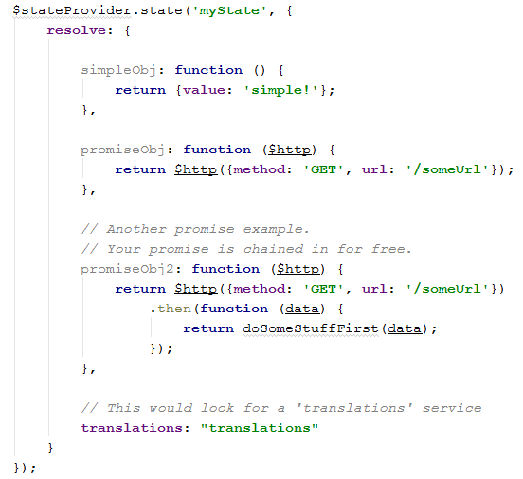
AngularJS
Using state param in URL resolve ....
Resolution gives a chance to prepare data and inject them in the controller when they are ready.

Slide 12

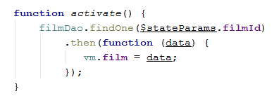
AngularJS
UI-Router syntax : JS Navigation to the state 'main.films.edit' with the URL param filmId
Starting the nav in JS :
On the FilmEditController : selection on the film to edit :

Slide 13
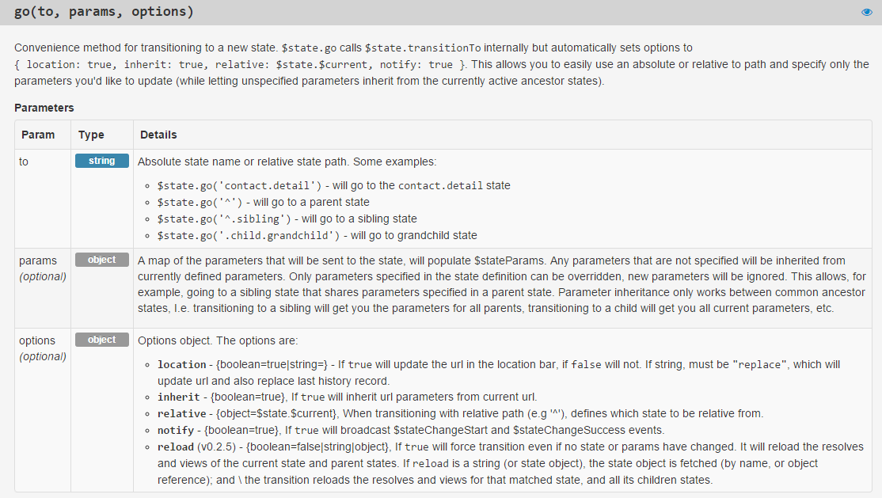
Router
$state.go
$state.go( state, {}, { reload : true});

Slide 14
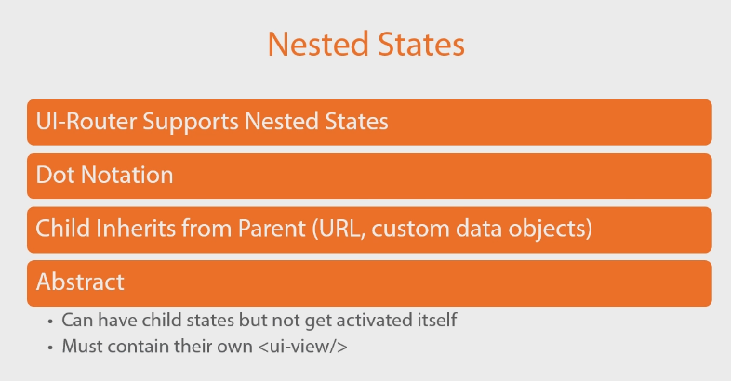
Router
Nested states

Slide 15
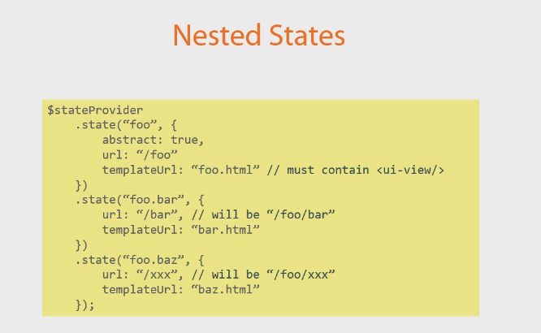
Router
Nested States

Slide 16
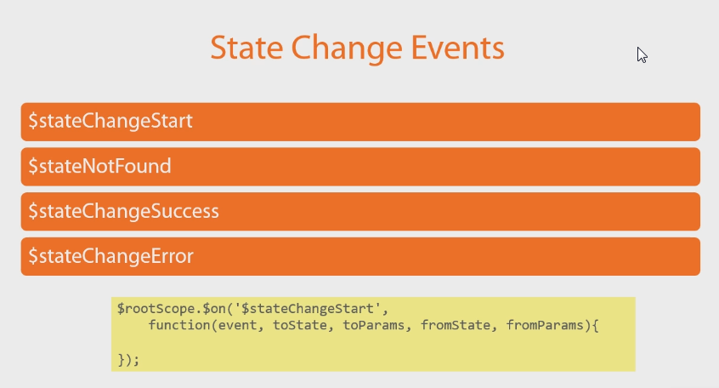
Router
Event

Slide 17
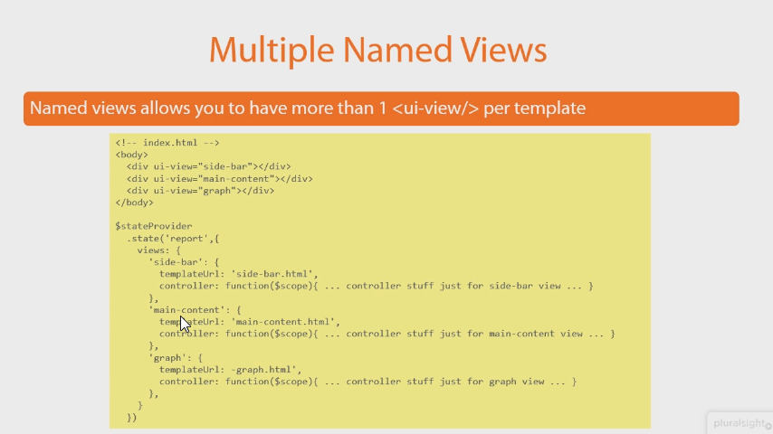
Router

Slide 18
AngularJS
PluralSight Angular UI Fundamental by Steve Michelotti
chapter 3 : UI-Router
http://www.pluralsight.com/courses/angularui-fundamentals

